Slide 1
Internship Studio
Ethical Hacking Internship
TASK-2
AISWARAYA UNNIKRISHNAN
uaiswarya769@gmail.com

Slide 2
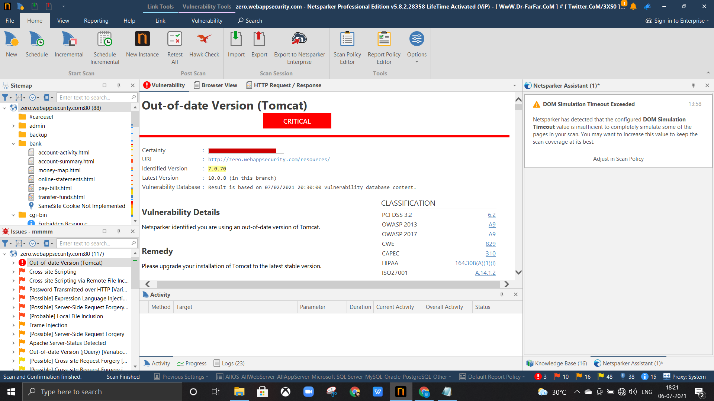
Automatic vulnerability scanner(Netsparker)

Slide 3
MY REPORT
Domain>> http://zero.webappsecurity.com/
Subdomain>>http://zero.webappsecurity.com/resources/
Testing enviornment
....
*windows 10,Netspark v5.8.2.28358(automatic Vulnerability Scanner)
Discription
......
*Critical Vulnerability(Out-of-date(Tomcat))was found.
Steps to reproduce
......
1)Opened Netspark v5.8.2.28358
2)Pasted the URL http://zero.webappsecurity.com/ to scan

Slide 4
3)scanned http://zero.webappsecurity.com/ using Netspark v5.8.2.28358
4)After Scanning Critical Vulnerability(Out-of-date(Tomcat))was found in its subdomain http://zero.webappsecurity.com/resources/
Vulnerability In Detail
......
Netsparker identified that you are using an out-of-date version of Tomcat(7.0.70)
Impact
......
Old version of Tomcat contain many bug. So a attacker can easly get into the sever using that vulnerability and explot that server and site belongs to the servers.
Solution
......
Upgrade tomcat to the latest version(10.0.8) which is more secure.

Slide 5
REPORT BY NETSPAKER
Vulnerability Details
Netsparker identified you are using an out-of-date version of Tomcat.
Remedy
Please upgrade your installation of Tomcat to the latest stable version.
Remedy References
Apache Tomcat Versions and Download
Known Vulnerabilities in this Version
Apache Tomcat Deserialization of Untrusted Data Vulnerability
The fix for CVE-2020-9484 was incomplete. When using Apache Tomcat 10.0.0-M1 to 10.0.0, 9.0.0.M1 to 9.0.41, 8.5.0 to 8.5.61 or 7.0.0. to 7.0.107 with a configuration edge case that was highly unlikely to be used, the Tomcat instance was still vulnerable to CVE-2020-9494. Note that both the previously published prerequisites for CVE-2020-9484 and the previously published mitigations for CVE-2020-9484 also apply to this issue.
Affected Versions
7.0.0 to 7.0.107

Slide 6
External References
CVE-2021-25329
Apache Tomcat Insufficient Information Vulnerability
Apache Tomcat through 7.0.x allows remote attackers to cause a denial of service (daemon outage) via partial HTTP requests, as demonstrated by Slowloris.
Affected Versions
7.0.0 to 7.0.100
External References
CVE-2012-5568

